Slide 1
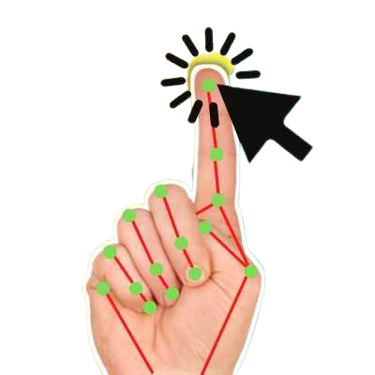
AI Virtual Mouse
Guided by : Rakshita Ma`am

Slide 2


Team Members
20MIM10001 - Anas Khan
20MIM10004 - Aditya Baraiya
20MIM10031 - Anam Rehman
20MIM10036 - Prakhyat Srivastava
20MIM10045 - Manan Patel

Slide 3
Presentation Outline
Introduction
Existing Work With Limitations
Proposed Work And Methodology
Novelty
Real Time Usage
Hardware & Software Requirement
Flowchart
Overall System Architecture
Module Split Up , Explanation and output

Slide 4

Introduction
With the development technologies in the areas of augmented reality and devices that we use in our daily life, these devices are becoming compact in the form of Bluetooth or wireless technologies.
This paper proposes an AI virtual mouse system that makes use of the hand gestures and hand tip detection for performing mouse functions in the computer using computer vision.
The main objective of the proposed system is to perform computer mouse cursor functions and scroll function using a web camera or a built-in camera in the computer instead of using a traditional mouse device.
Hand gesture and hand tip detection by using computer vision is used as a HCI with the computer.
With the use of the AI virtual mouse system, we can track the fingertip of the hand gesture by using a built-in camera or web camera and perform the mouse cursor operations and scrolling function and also move the cursor with it.

Slide 5

Existing Work Limitation
In earlier models , the user had to wear special gloves in which fingers and palm were differentiated using different colors which made it easy for the program to understand the gestures.In contrary to this our model does not require any special gloves to understand the gestures.It can differentiate between the fingers and palm on its own.
Our virtual mouse has achieved 70% accuracy and we are trying to reach 95% accuracy in future.

Slide 6

Proposed Work & Methodology
The main objective of the proposed AI virtual mouse system is to develop an alternative to the regular and traditional mouse system to perform and control the mouse functions, and this can be achieved with the help of a web camera that captures the hand gestures and hand tip and then processes these frames to perform the particular mouse function such as left click, right click, and scrolling function.

Slide 7

Novelty
In earlier models , the user had to wear special gloves in which fingers and palm were differentiated using different colors which made it easy for the program to understand the gestures.In contrary to this our model does not require any special gloves to understand the gestures.It can differentiate between the fingers and palm on its own.
The novelty of the proposed model is that it can perform most of the mouse functions such as left click and mouse cursor movement using fingertip detection, and also, the model is helpful in controlling the PC like a physical mouse but in the virtual mode.

Slide 8

Real time usage
Amidst the COVID-19 situation, it is not safe to use the devices by touching them because it may result in a possible situation of spread of the virus by touching the devices, so the proposed AI virtual mouse can be used to control the PC mouse functions without using the physical mouse
The system can be used to control robots and automation systems without the usage of devices
2D and 3D images can be drawn using the AI virtual system using the hand gestures
AI virtual mouse can be used to play virtual reality- and augmented reality-based games without the wireless or wired mouse devices.
Persons with problems in their hands can use this system to control the mouse functions in the computer

Slide 9
Software & Hardware Requirements
Processor : Core of any generation
Main Memory : 4GB RAM
Hard Disk : 128 GB and more
Display : 14" Monitor
Webcam (720p)
OS : Window 10 64-bit
Language : Python 3.8.0
Python Library : Open CV, AutoPy , Mediapipe (0.8.3.1)

Slide 10
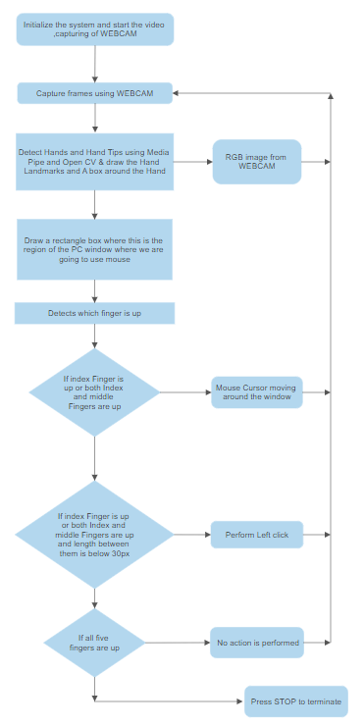
Flowchart

Slide 11
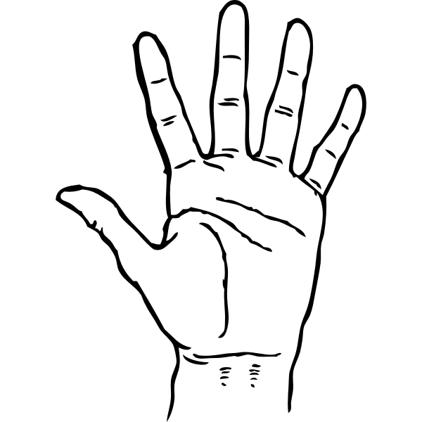
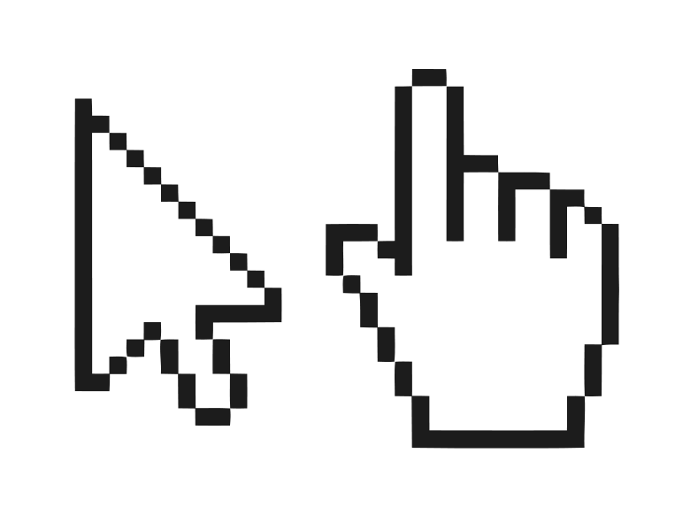


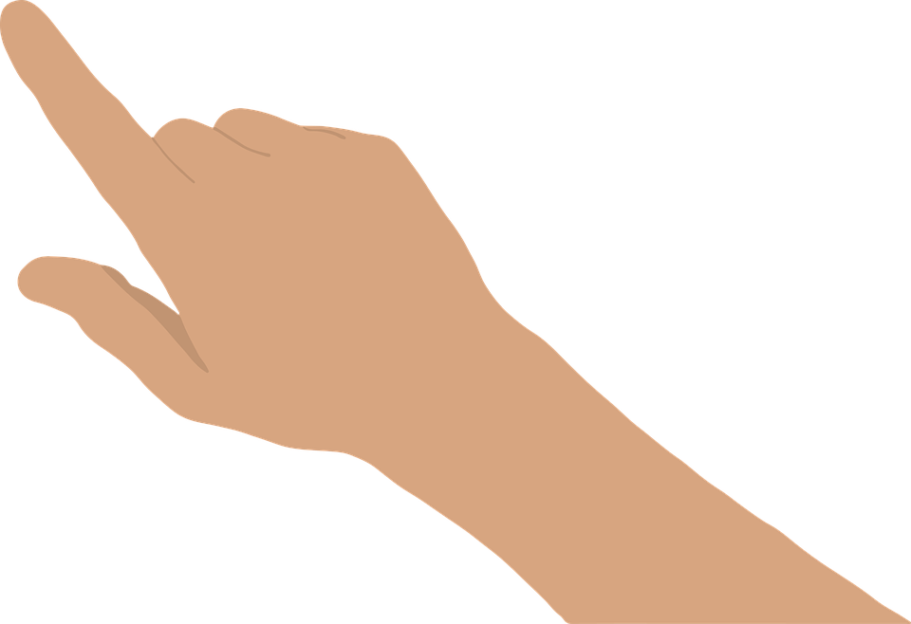

Overall system Architecture
Hand Detection
Control Mouse Using Hand Gesture
Capture frame using webcam
Image processing and drawing using Open CV
Hand Tracking Using Mediapipe
Controlling The Mouse Movement And Click Using Autopy

Slide 12
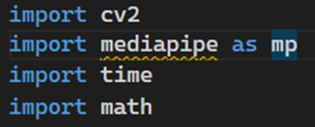
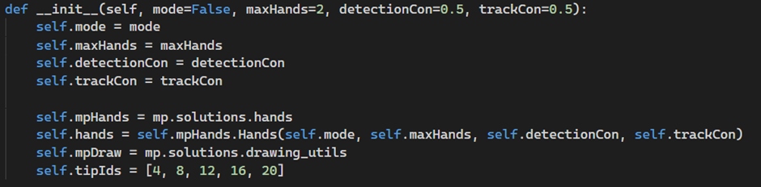
Libraries that we are using
Function for hand detection
We are using hand tracking module from opencv in this module we are using this objects

Slide 13
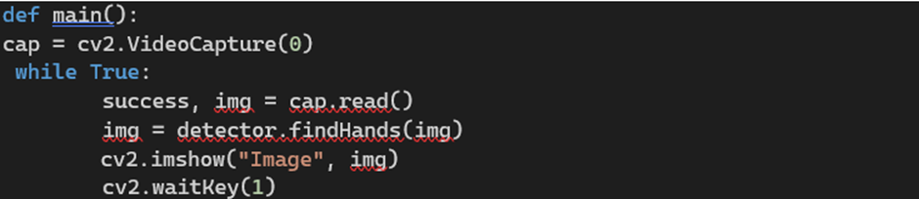
For hand tracking we are going to make four different classes :
class handDetector()
def findHands(self, img, draw=True):
def findPosition(self, img, handNo=0, draw=True):
def findDistance(self, p1, p2, img, draw=True, r=15, t=3):
def main():
First one is the find position
Second one is the find hand
Third one is the find distance
Fourth one is to run our code main function
And in the main function we are going to connect a webcam to the pc so it can detect and track the hand for that we have to do

Slide 14
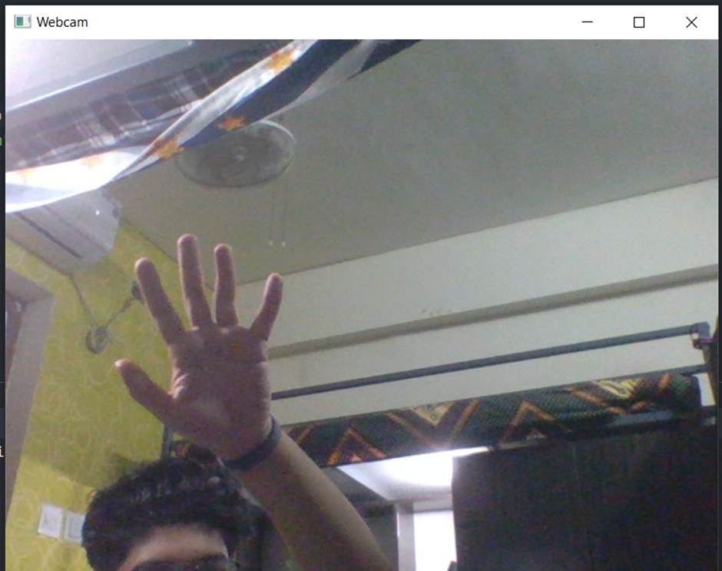
Output

Slide 15
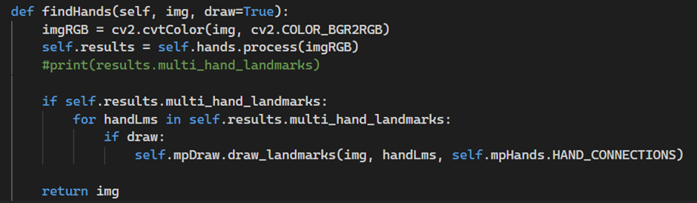
So till now we are able to see our hand now we have to detect our hand, for that
This mpDraw function will detect all landmark on our hand

Slide 16
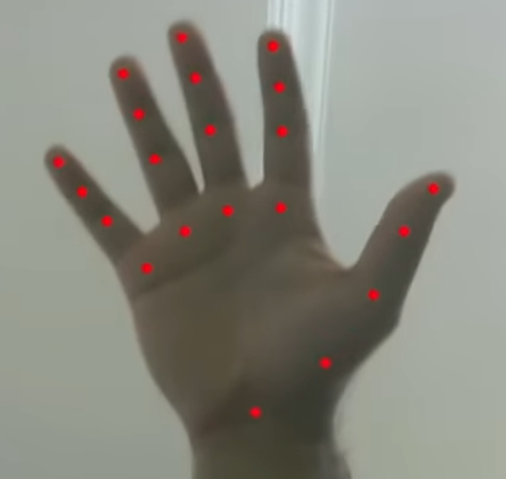
Output

Slide 17
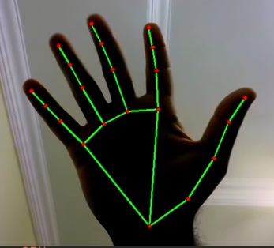
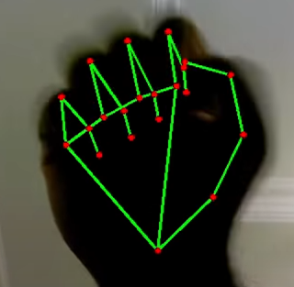
Now we want to track our hand gesture for that we will use this statement
Output:

Slide 18
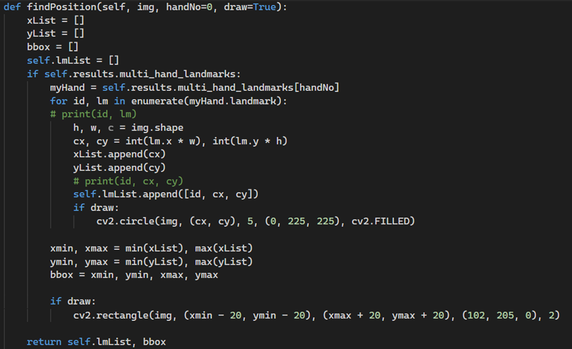
Now we get all the values of our hand landmarks but we still don’t know how to use it for tracking
For that we have to make another function for that we called as find position

Slide 19
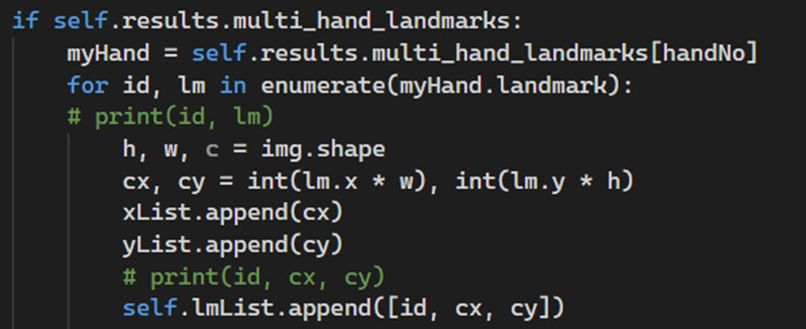
This is the whole function in this function we are finding our hand’s landmarks position to take help for our purpose.
For that we are writing this statement

Slide 20
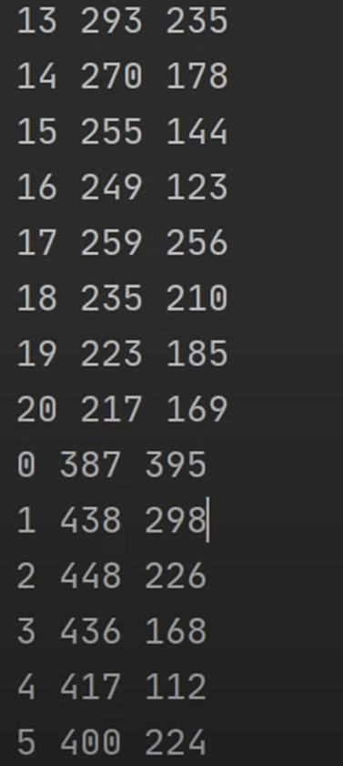
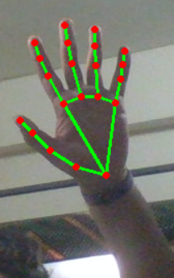
Output:

Slide 21
Thank You !

